Slide 1
Revenue Sharing Token Investment Opportunity
Central Broward Construction
Earning cashflow from Profitable Construction Projects in Florida
Revenue Sharing Tokens issued By: CT Central Brower Construction Tokens, LLC

Slide 2
Investment Opportunity
Revenue-Sharing Token Holders- Receive a Percentage Of Central Broward Construction Company’s Gross Revenue From Construction Contracts.

Slide 3
Introduction To The Central Broward Construction Company
Central Broward Construction is an established, 50-year-old, construction company with a strong track record in residential, commercial, and infrastructure projects.
Mission: To deliver high-quality construction solutions with efficiency and reliability.
Vision: To be a leading masonry and concrete construction company in Florida, offering sustainable solutions.

Slide 4
Market Opportunity
As of March 2025, Florida's commercial construction sector is poised for significant growth, driven by various economic and demographic factors.​
Market Growth Projections:
Industry Expansion: The Commercial Building Construction industry in Florida is projected to reach $17.1 billion by the end of 2025, reflecting a steady annual growth rate over the past five years. ​IBISWorld
Key Trends Influencing the Sector:
Sustainability and Resilience: Developers are increasingly adopting sustainable practices, integrating solar energy, green roofs, and recycled materials. Emphasis on storm-resistant designs is paramount, especially given Florida's susceptibility to hurricanes and flooding. ​
Technological Integration: The adoption of advanced technologies, including construction robotics and automation, is on the rise to enhance efficiency and address labor shortages. ​
Labor Market Dynamics:
Workforce Challenges: Approximately 80% of contractors report difficulties in sourcing qualified labor, with 69% planning to expand their workforce in 2025, underscoring the sector's optimism. ​
Regional Highlights:
Tampa Bay Area: This region is experiencing significant developments, driven by population growth and economic expansion. Major projects, such as the $6.5 billion redevelopment of the Historic Gas Plant District in St. Petersburg, are set to transform the local landscape. ​Tampa Bay Business & Wealth
In summary, Florida's commercial construction market is on an upward trajectory for 2025, propelled by sustainable initiatives, technological advancements, and robust regional projects. However, addressing labor shortages and navigating economic pressures will be crucial for sustained growth.​

Slide 5
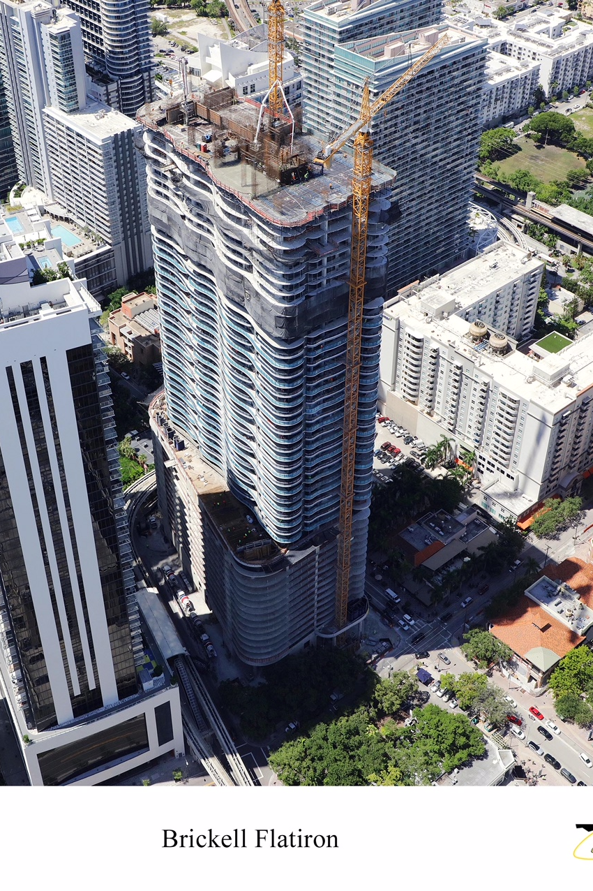
Central Boward Construction’s Former Projects
Residential and Multifamily
CBC delivers diversity with Award winning exposed masonry and showcasing craftsmanship. Concentrating mostly on large homes, multi-family, mid- and high-rise construction

Slide 6
Commercial and Industrial Projects
Las Olas Parking Garage Las Olas Blvd. Fort Lauderdale
Architect: n/A
General Contractor: Sanska

Slide 7
Government and Schools Projects
Terminal 4 FIA/ATO Expansion Phase 1B Hollywood, FL
Owner: Ft. Lauderdale / Hollywood International Airport
Project Type: Office Building
Architect: Zyscovich Architects
General Cont
ractor: Balfour Beatty / James A. Cummings

Slide 8
Government and Schools Projects
Cypress Bay High School Broward County
Project Type: Office Building
Architect: ZYSCOVICH ARCHITECTS
General Contractor: Morganti

Slide 9
Expansion Plans
Expansion Opportunity with Florida’s Economic Tailwinds
Central Broward Construction is on the verge of a major expansion, poised to strengthen its balance sheet and take a leadership role in Florida’s infrastructure rebuild.
Florida’s Economic Tailwinds: Post-Hurricane Rebuilding: Billions allocated for hurricane-resistant infrastructure. Flood Mitigation & Resiliency: Demand for advanced flood mitigation techniques. Building Code Changes: New regulations post-Surfside condo collapse drive property upgrades. Population Growth: Strong in-migration trends boosting residential and commercial development.

Slide 10
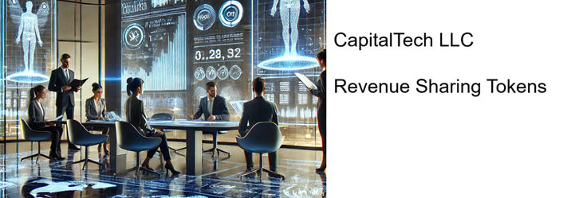
What are Revenue Sharing Tokens?
Revenue Sharing Tokens – digital securities issued on a blockchain that represent a share of the revenue generated by a specific project or investment.
In simpler terms, when you purchase a CapitalTech revenue-sharing token, you are buying a fraction of the future gross revenue streams of an underlying company.
This model merges the security of traditional finance with the efficiency of blockchain technology, creating a professional, engaging, and easy-to-understand investment experience for participants.

Slide 11
Financial Proforma for the CT Central Broward Construction Revenue Sharing Token Opportunity
Minimum Token Investment Amount $1,000
Total Investment: $10,000,000
Returns Over five years:
Profit Sharing: $6,875,000.
Capital Event Fee: $3,125,000.
Total Return: $20,000,000.
Performance Metrics
Projected Annual IRR: 21.82%
Equity Multiple: 2x
Capital Event Valuation Projection
Year 5 EBIDA: $23,200,000
Company’s Sale Valuation at 4X Multiple: $92,800,000
Summary
This revenue-sharing proforma indicates a strong return on investment with a projected annual IRR of 21.82% and an equity multiple of 2x. The valuation after 5 years is projected to be $92,800 based on an EBIDA of $23,200,000 multiplied by a 4X valuation multiple. The payout structure includes profit-sharing and a capital event that contributes to the overall return.
This revenue-sharing proforma provided is for
informational purposes only and is intended to
outline potential revenue-sharing opportunities
The information contained in this Proforma is
based on projections, estimates, and assumptions that are inherently uncertain and subject to change.

Slide 12
Why Invest in Central Broward Construction
Competitive Advantages:
- Experienced management team.
- Proven track record of successful projects.
- Established relationships with suppliers and subcontractors.
Scalability:
- Expansion opportunities across Florida.
- Potential for the awarding of larger projects.

Slide 13
Call to Action
Buy Your Tokens Today
Disclaimer
This presentations contains confidential and proprietary information to be used solely for purposes of discussion, to determine preliminary interest in establishing a business relationship with CapitalTech, LLC. Under no circumstances are these presentations to be used or considered as an offer to sell, or a solicitation of an offer to buy any security. Any such offer may only be made pursuant to a prospectus, or other offering documents, meeting the requirement of applicable Federal and State securities laws. The information contained herein is in summary form for the convenience of presentation. It is not complete, and it should not be relied upon as such.

